Slide 1


Chapter 2
Basics of
Algorithm Analysis
Slides by Kevin Wayne.
Copyright © 2005 Pearson-Addison Wesley.
All rights reserved.

Slide 2
Computational Tractability
``For me, great algorithms are the poetry of computation. Just like verse, they can be terse, allusive, dense, and even mysterious. But once unlocked, they cast a brilliant new light on some aspect of computing."-- Francis Sullivan, Science, Vol. 287, No. 5454, p. 799, February 2000.

Slide 3
Polynomial-Time
Brute force. For many non-trivial problems, there is a natural brute force search algorithm that checks every possible solution.
  Typically takes 2^{n} time or worse for inputs of size n.
  Unacceptable in practice.
Desirable scaling property. When the input size doubles, the algorithm should only slow down by some constant factor C.
Def. An algorithm is poly-time if the above scaling property holds.
There exists constants c > 0 and d > 0 such that on every input of size n, its running time is bounded by c n^{d} steps.
Notes:
focusing on worst-case poly-time is a subtle modeling decision - we try to justify it here

Slide 4
Worst-Case Analysis
Worst case running time. Obtain bound on largest possible running time of algorithm on input of a given size n.
  Generally captures efficiency in practice.
  Hard to find effective alternative.
Def. An algorithm is efficient if its running time is polynomial.
Justification: It really works in practice!
  In practice, the poly-time algorithms that people develop almost always have low constants and low exponents.
  Breaking through the exponential barrier of brute force typically exposes some crucial structure of the problem.
Exceptions.
  Some poly-time algorithms do have high constants and/or exponents, and are useless in practice.
  Some exponential-time algorithms are widely used because the worst-case instances seem to be rare.

Slide 5
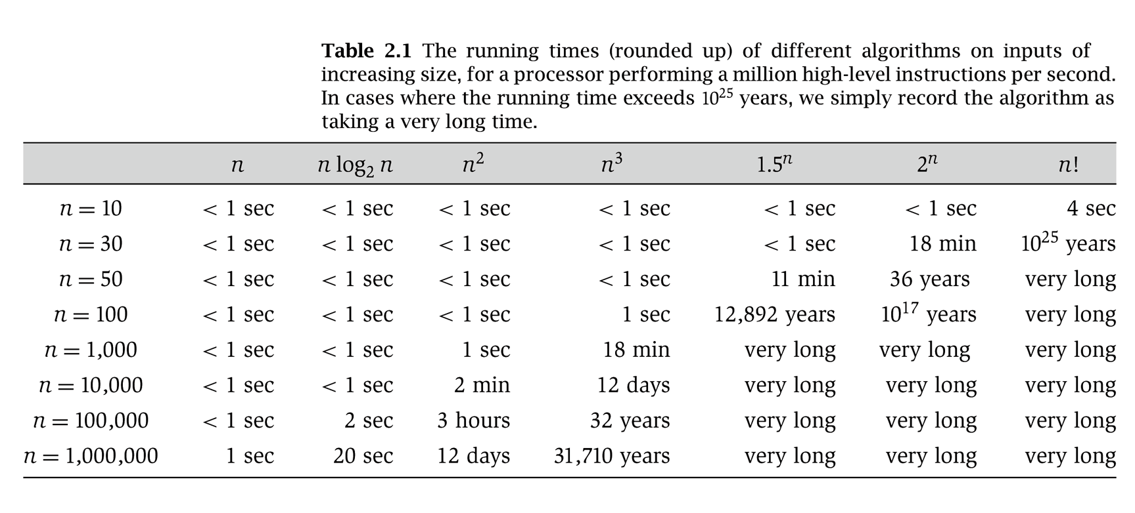
Why It Matters
Notes:
table taken from More Programming Pearls, p. 82, 400MhZ Pentium II scaled up
one step takes one nanosecond
msec = millisecond

Slide 6
2.2 Asymptotic Order of Growth

Slide 7
Asymptotic Order of Growth
Upper bounds. T(n) is O(f(n)) if there exist constants c > 0 and n₀ ≥ 0 such that for all n ≥ n₀ we have T(n) ≤ c · f(n).
Lower bounds. T(n) is Ω(f(n)) if there exist constants c > 0 and n₀ ≥ 0 such that for all n ≥ n₀ we have T(n) ≥ c · f(n).
Tight bounds. T(n) is Θ(f(n)) if T(n) is both O(f(n)) and Ω(f(n)).
Ex: T(n) = 32n² + 17n + 32.
  T(n) is O(n²), O(n³), Ω(n²), Ω(n), and Θ(n²) .
  T(n) is not O(n), Ω(n³), Θ(n), or Θ(n³).
Equals sign. O(f (n)) is a set of functions, but we often write
T(n) = O(f (n)) instead of T(n) ∈ O(f(n)).

Slide 8
Properties
Transitivity.
  If f = O(g) and g = O(h) then f = O(h).
  If f = Ω(g) and g = Ω(h) then f = Ω(h).
  If f = Θ(g) and g = Θ(h) then f = Θ(h).
Additivity.
  If f = O(h) and g = O(h) then f + g = O(h).
  If f = Ω(h) and g = Ω(h) then f + g = Ω(h).
  If f = Θ(h) and g = Θ(h) then f + g = Θ(h).

Slide 9
Asymptotic Bounds for Some Common Functions
Polynomials. a₀ + a₁n + … + a_{d}n^{d} is Θ(n^{d}) if a_{d} > 0.
Polynomial time. Running time is O(n^{d}) for some constant d independent of the input size n.
Logarithms. O(log _{a} n) = O(log _{b} n) for any constants a, b > 1.
Logarithms. For every x > 0, log n = O(n^{x}).
Exponentials. For every r > 1 and every d > 0, n^{d} = O(r^{n}).
log grows slower than every polynomial
every exponential grows faster than every polynomial

Slide 10
2.4 A Survey of Common Running Times

Slide 11
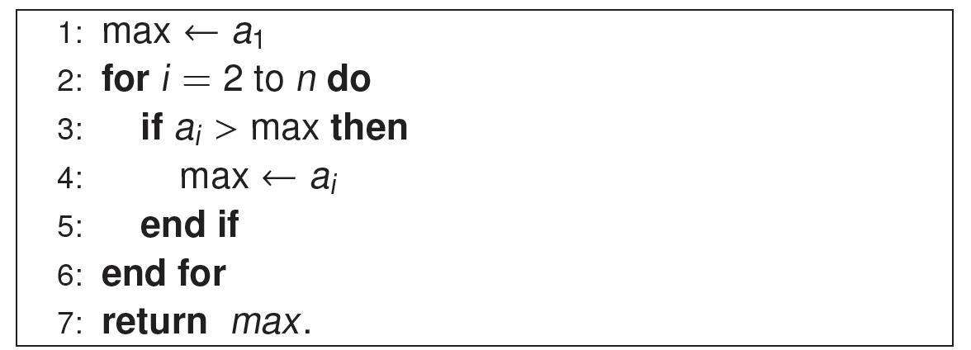
Linear Time: O(n)
Linear time. Running time is at most a constant factor times the size of the input.
Computing the maximum. Compute maximum of n numbers a₁, …, a_{n}.

Slide 12
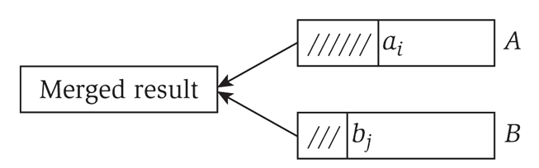
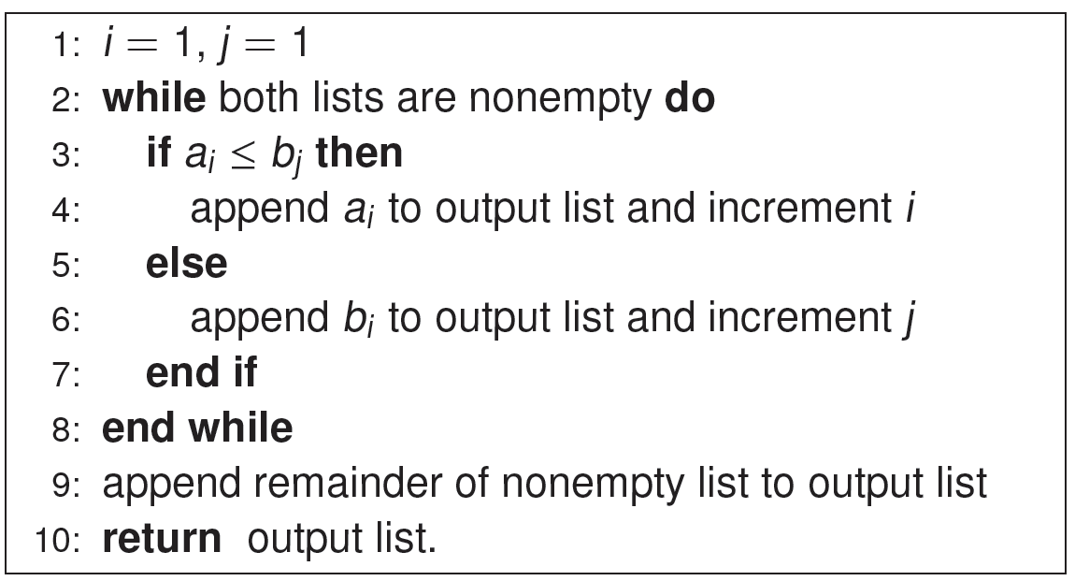
Linear Time: O(n)
Merge. Combine two sorted lists A = a₁,a₂,…,a_{n} with B = b₁,b₂,…,b_{n} into sorted whole.
Claim. Merging two lists of size n takes O(n) time.
Pf. After each comparison, the length of output list increases by 1.

Slide 13
O(n log n) Time
O(n log n) time. Arises in divide-and-conquer algorithms.
Sorting. Mergesort and heapsort are sorting algorithms that perform O(n log n) comparisons.
Largest empty interval. Given n time-stamps x₁, …, x_{n} on which copies of a file arrive at a server, what is largest interval of time when no copies of the file arrive?
O(n log n) solution. Sort the time-stamps. Scan the sorted list in order, identifying the maximum gap between successive time-stamps.

Slide 14
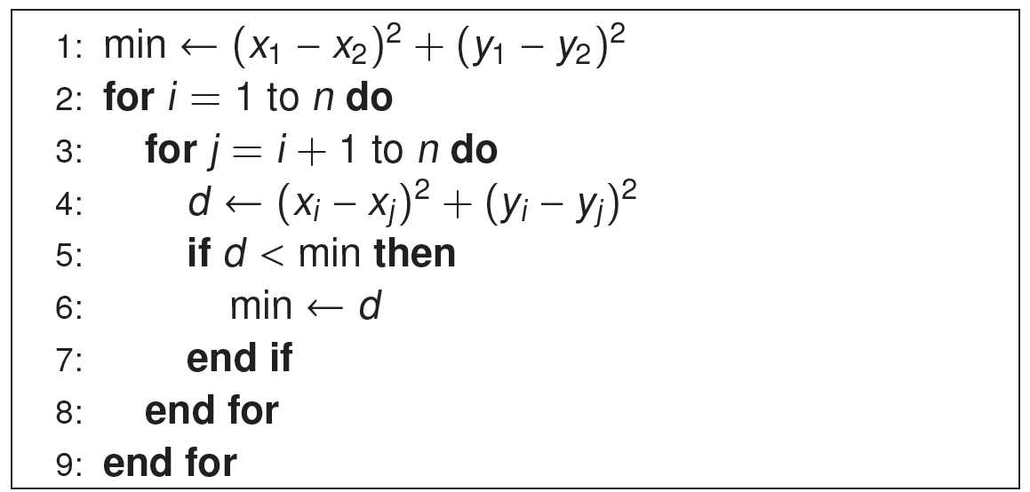
Quadratic Time: O(n²)
Quadratic time. Enumerate all pairs of elements.
Closest pair of points. Given a list of n points in the plane (x₁, y₁), …, (x_{n}, y_{n}), find the pair that is closest.
O(n²) solution. Try all pairs of points.
Remark. Ω(n²) seems inevitable, but this is just an illusion.

Slide 15
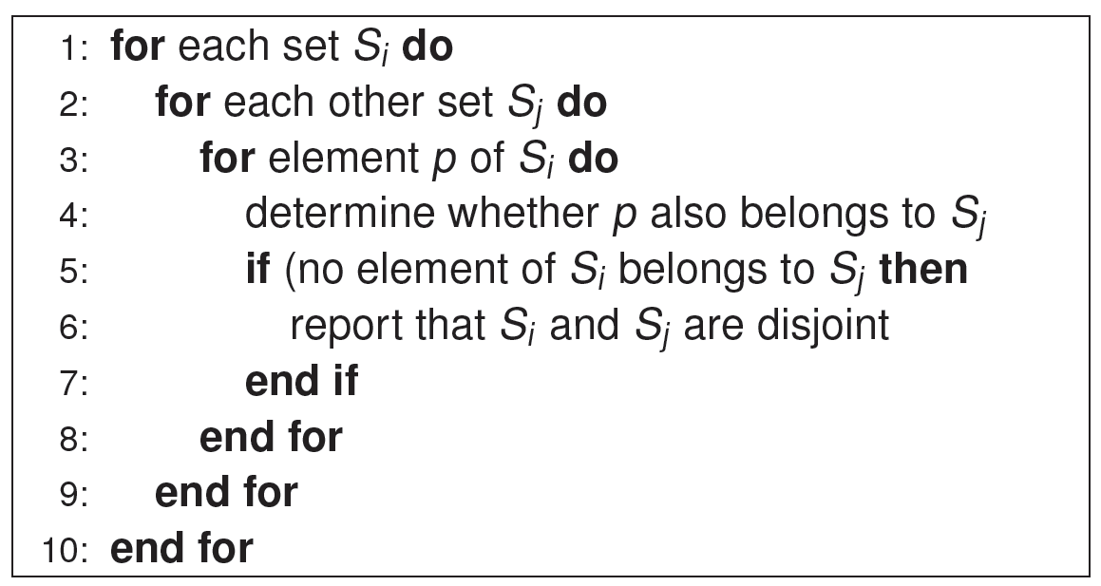
Cubic Time: O(n³)
Cubic time. Enumerate all triples of elements.
Set disjointness. Given n sets S₁, …, S_{n} each of which is a subset of
1, 2, …, n, is there some pair of these which are disjoint?
O(n³) solution. For each pairs of sets, determine if they are disjoint.

Slide 16
Exponential Time
Independent set. Given a graph, what is maximum size of an independent set?
O(n² 2^{n}) solution. Enumerate all subsets.

Slide 17
Homework
Read Chapter 2 of the textbook.
Exercises 6 & 8 in Chapter 2.

